Slide 1
Design for High Availability

Slide 2
Objectives
After completing this lesson, you should be able to:
  Design a Maximum Availability Architecture in your environment
  Determine the best RAC and Data Guard topologies for your environment
  Configure the Data Guard Broker configuration files in a RAC environment
  Decide on the best ASM configuration to use
  Patch your RAC system in a rolling fashion
Notes:
Oracle Database 11g: RAC Administration 12 - <number>

Slide 3
Causes of Unplanned Down Time
Unplanned Down time
Software failures
Hardware failures
Human errors
Disasters
Operating system
CPU
Operator error
Fire
Database
Memory
User error
Flood
Middleware
Power supply
DBA
Earthquake
Application
Bus
System admin.
Power failure
Network
Disk
Sabotage
Bombing
Tape
Controllers
Network
Power
Notes:
Causes of Unplanned Down Time
One of the true challenges in designing a highly available solution is examining and addressing all the possible causes of down time. It is important to consider causes of both unplanned and planned down time. The schema shown in the slide, which is a taxonomy of unplanned failures, classifies failures as software failures, hardware failures, human error, and disasters. Under each category heading is a list of possible causes of failures related to that category.
Software failures include operating system, database, middleware, application, and network failures. A failure of any one of these components can cause a system fault.
Hardware failures include system, peripheral, network, and power failures.
Human error, which is a leading cause of failures, includes errors by an operator, user, database administrator, or system administrator. Another type of human error that can cause unplanned down time is sabotage.
The final category is disasters. Although infrequent, these can have extreme impacts on enterprises, because of their prolonged effect on operations. Possible causes of disasters include fires, floods, earthquakes, power failures, and bombings. A well-designed high-availability solution accounts for all these factors in preventing unplanned down time.

Slide 4
Causes of Planned Down Time
Planned down time
Routine operations
Periodic maintenance
New deployments
Backups
Storage maintenance
HW upgrade
Performance mgmt
Initialization parameters
OS upgrades
Security mgmt
Software patches
DB upgrades
Batches
Schema management
MidW upgrades
Operating system
App upgrades
Middleware
Net upgrades
Network
Notes:
Causes of Planned Down Time
Planned down time can be just as disruptive to operations, especially in global enterprises that support users in multiple time zones, up to 24 hours per day. In these cases, it is important to design a system to minimize planned interruptions. As shown by the schema in the slide, causes of planned down time include routine operations, periodic maintenance, and new deployments. Routine operations are frequent maintenance tasks that include backups, performance management, user and security management, and batch operations.
Periodic maintenance, such as installing a patch or reconfiguring the system, is occasionally necessary to update the database, application, operating system middleware, or network.
New deployments describe major upgrades to the hardware, operating system, database, application, middleware, or network. It is important to consider not only the time to perform the upgrade, but also the effect the changes may have on the overall application.

Slide 5
Oracle’s Solution to Down Time
RMAN backup/recovery
(Data Recovery Advisor)
Fast-start
Fault Recovery
RAC
Data Guard
Streams
ASM
System
failures
Flashback
Unplanned
down time
Data
failures
HARD
Data Guard
&
Streams
Rolling upgrades/
Online patching
System
changes
Planned
down time
Dynamic provisioning
Data
changes
Online redefinition
Notes:
Oracle’s Solution to Down Time
Unplanned down time is primarily the result of computer failures or data failures. Planned down time is primarily due to data changes or system changes:
RAC provides optimal performance, scalability, and availability gains.
Fast-Start Fault Recovery enables you to bound the database crash/recovery time. The database self-tunes checkpoint processing to safeguard the desired recovery time objective.
ASM provides a higher level of availability using online provisioning of database storage.
Flashback provides a quick resolution to human errors.
Oracle Hardware Assisted Resilient Data (HARD) is a comprehensive program designed to prevent data corruptions before they happen.
Recovery Manager (RMAN) automates database backup and recovery. Data Recovery Advisor (not supported for RAC) diagnoses data failures and presents repair options.
Data Guard must be the foundation of any Oracle database disaster-recovery plan.
The increased flexibility and capability of Streams over Data Guard with SQL Apply requires more investment and expertise to maintain an integrated high availability solution.
With online redefinition, the Oracle database supports many maintenance operations without disrupting database operations, or users updating or accessing data.
The Oracle database continues to broaden support for dynamic reconfiguration, enabling it to adapt to changes in demand and hardware with no disruption of service.
The Oracle database supports the application of patches to the nodes of a RAC system, as well as database software upgrades, in a rolling fashion.

Slide 6
RAC and Data Guard Complementarity
Resource
Cause
Protection
Nodes
RAC
Component
Instances
failure
RAC
Software failure
Human
error
Data Guard
&
Flashback
Data
Environment
Data Guard
&
Streams
Site
Notes:
RAC and Data Guard Complementarity
RAC and Data Guard together provide the benefits of system-level, site-level, and data-level protection, resulting in high levels of availability and disaster recovery without loss of data:
RAC addresses system failures by providing rapid and automatic recovery from failures, such as node failures and instance crashes.
Data Guard addresses site failures and data protection through transactionally consistent primary and standby databases that do not share disks, enabling recovery from site disasters and data corruption.
Note: Unlike Data Guard using SQL Apply, Oracle Streams enables updates on the replica and provides support for heterogeneous platforms with different database releases. Therefore, Oracle Streams may provide the fastest approach for database upgrades and platform migration.

Slide 7
Maximum Availability Architecture
Real-time query
Clients
Oracle
Application
Server
Oracle
Application
Server
WAN Traffic
Manager
Real-time query
Primary
site
Secondary
site
Data Guard
RAC
database
RAC databases:
Phys&log standby
Notes:
Maximum Availability Architecture (MAA)
RAC and Data Guard provide the basis of the database MAA solution. MAA provides the most comprehensive architecture for reducing down time for scheduled outages and preventing, detecting, and recovering from unscheduled outages. The recommended MAA has two identical sites. The primary site contains the RAC database, and the secondary site contains both a physical standby database and a logical standby database on RAC. Identical site configuration is recommended to ensure that performance is not sacrificed after a failover or switchover. Symmetric sites also enable processes and procedures to be kept the same between sites, making operational tasks easier to maintain and execute.
The graphic illustrates identically configured sites. Each site consists of redundant components and redundant routing mechanisms, so that requests are always serviceable even in the event of a failure. Most outages are resolved locally. Client requests are always routed to the site playing the production role.
After a failover or switchover operation occurs due to a serious outage, client requests are routed to another site that assumes the production role. Each site contains a set of application servers or mid-tier servers. The site playing the production role contains a production database using RAC to protect from host and instance failures. The site playing the standby role contains one standby database, and one logical standby database managed by Data Guard. Data Guard switchover and failover functions allow the roles to be traded between sites.
Note: For more information, see the following Web site: http://otn.oracle.com/deploy/availability/htdocs/maa.htm

Slide 8
RAC and Data Guard Topologies
  Symmetric configuration with RAC at all sites:
    Same number of instances
    Same service preferences
  Asymmetric configuration with RAC at all sites:
    Different number of instances
    Different service preferences
  Asymmetric configuration with mixture of RAC and single instance:
    All sites running under Oracle Clusterware
    Some single-instance sites not running under Oracle Clusterware
Notes:
RAC and Data Guard Topologies
You can configure a standby database to protect a primary database in a RAC environment. Basically, all kinds of combinations are supported. For example, it is possible to have your primary database running under RAC and your standby database running as a single-instance database. It is also possible to have both the primary and standby databases running under RAC.
The slide explains the distinction between symmetric environments and asymmetric ones.
If you want to create a symmetric environment running RAC, then all databases need to have the same number of instances and the same service preferences. As the DBA, you need to make sure that this is the case by manually configuring them in a symmetric way.
However, if you want to benefit from the tight integration of Oracle Clusterware and Data Guard Broker, make sure that both the primary site and the secondary site are running under Oracle Clusterware and that both sites have the same services defined.
Note: Beginning with Oracle Database release 11g, the primary and standby systems in a Data Guard configuration can have different CPU architectures, operating systems (for example, Windows and Linux for physical standby database only with no EM support for this combination), operating system binaries (32-bit and 64-bit), and Oracle database binaries (32-bit and 64-bit). For the latest capabilities and restrictions, see Metalink note 413484.1 at https://metalink.oracle.com/.

Slide 9
RAC and Data Guard Architecture
Primary instance A
Standby receiving instance C
ARCn
ARCn
LGWR
RFS
Flash
recovery
area
Primary
database
Standby
redo
files
Online
redo
files
Flash
recovery
area
Standby
database
LGWR
RFS
Apply
ARCn
ARCn
Primary instance B
Standby apply instance D
Notes:
RAC and Data Guard Architecture
Although it is perfectly possible to use a “RAC to single-instance Data Guard (DG)” configuration, you also have the possibility to use a RAC-to-RAC DG configuration. In this mode, although multiple standby instances can receive redo from the primary database, only one standby instance can apply the redo stream generated by the primary instances.
A RAC-to-RAC DG configuration can be set up in different ways, and the slide shows you one possibility with a symmetric configuration where each primary instance sends its redo stream to a corresponding standby instance using standby redo log files. It is also possible for each primary instance to send its redo stream to only one standby instance that can also apply this stream to the standby database. However, you can get performance benefits by using the configuration shown in the slide. For example, assume that the redo generation rate on the primary is too great for a single receiving instance on the standby side to handle. Suppose further that the primary database is using the SYNC redo transport mode. If a single receiving instance on the standby cannot keep up with the primary, then the primary’s progress is going to be throttled by the standby. If the load is spread across multiple receiving instances on the standby, then this is less likely to occur.
If the standby can keep up with the primary, another approach is to use only one standby instance to receive and apply the complete redo stream. For example, you can set up the primary instances to remotely archive to the same Oracle Net service name.

Slide 10
Notes only page
Notes:
RAC and Data Guard Architecture (continued)
You can then configure one of the standby nodes to handle that service. This instance then both receives and applies redo from the primary. If you need to do maintenance on that node, then you can stop the service on that node and start it on another node. This approach allows for the primary instances to be more independent of the standby configuration because they are not configured to send redo to a particular instance.
Note: For more information, refer to the Oracle Data Guard Concepts and Administration guide.

Slide 11
Data Guard Broker (DGB) and
Oracle Clusterware (OC) Integration
  OC manages intrasite HA operations.
  OC manages intrasite planned HA operations.
  OC notifies when manual intervention is required.
  DBA receives notification.
  DBA decides to switch over or fail over using DGB.
  DGB manages intersite planned HA operations.
  DGB takes over from OC for intersite failover, switchover, and protection mode changes:
    DMON notifies OC to stop and disable the site, leaving all or one instance.
    DMON notifies OC to enable and start the site according to the DG site role.
Notes:
Data Guard Broker (DGB) and Oracle Clusterware (OC) Integration
DGB is tightly integrated with Oracle Clusterware. Oracle Clusterware manages individual instances to provide unattended high availability of a given clustered database. DGB manages individual databases (clustered or otherwise) in a Data Guard configuration to provide disaster recovery in the event that Oracle Clusterware is unable to maintain availability of the primary database.
For example, Oracle Clusterware posts NOT_RESTARTING events for the database group and service groups that cannot be recovered. These events are available through Enterprise Manager, ONS, and server-side callouts. As a DBA, when you receive those events, you might decide to repair and restart the primary site, or to invoke DGB to fail over if not using Fast-start Failover.
DGB and Oracle Clusterware work together to temporarily suspend service availability on the primary database, accomplish the actual role change for both databases during which Oracle Clusterware works with the DGB to properly restart the instances as necessary, and then to resume service availability on the new primary database. The broker manages the underlying Data Guard configuration and its database roles whereas Oracle Clusterware manages service availability that depends upon those roles. Applications that rely upon Oracle Clusterware for managing service availability will see only a temporary suspension of service as the role change occurs within the Data Guard configuration.

Slide 12
Fast-Start Failover: Overview
  Fast-Start Failover implements automatic failover to a standby database:
    Triggered by failure of site, hosts, storage, data file offline immediate, or network
    Works with and supplements RAC server failover
  Failover occurs in seconds (< 20 seconds).
    Comparable to cluster failover
  Original production site automatically rejoins the configuration after recovery.
  Automatically monitored by an Observer process:
    Locate it on a distinct server on a distinct data center
    Enterprise Manager can restart it on failure
    Installed through Oracle Client Administrator
Notes:
Fast-Start Failover: Overview
Fast-Start Failover is an Oracle Data Guard 10g Release 2 feature that automatically, quickly, and reliably fails over to a designated, synchronized standby database in the event of loss of the primary database, without requiring manual intervention to execute the failover. In addition, following a fast-start failover, the original primary database is automatically reconfigured as a new standby database upon reconnection to the configuration. This enables Data Guard to restore disaster protection in the configuration as soon as possible.
Fast-Start Failover is used in a Data Guard configuration under the control of the Data Guard Broker, and may be managed using either DGMGRL or Oracle Enterprise Manager 10g Grid Control. There are three essential participants in a Fast-Start Failover configuration:
The primary database, which can be a RAC database
A target standby database, which becomes the new primary database following a fast-start failover.
The Fast-Start Failover Observer, which is a separate process incorporated into the DGMGRL client that continuously monitors the primary database and the target standby database for possible failure conditions. The underlying rule is that out of these three participants, whichever two can communicate with each other will determine the outcome of the fast-start failover. In addition, a fast-start failover can occur only if there is a guarantee that no data will be lost.

Slide 13
Notes only page
Notes:
Fast-Start Failover: Overview (continued)
For disaster recovery requirements, install the Observer in a location separate from the primary and standby data centers. If the designated Observer fails, Enterprise Manager can detect the failure and can be configured to automatically restart the Observer on the same host.
You can install the Observer by installing the Oracle Client Administrator (choose the Administrator option from the Oracle Universal Installer). Installing the Oracle Client Administrator results in a small footprint because an Oracle instance is not included on the Observer system. If Enterprise Manager is used, also install the Enterprise Manager Agent on the Observer system.

Slide 14

Data Guard Broker Configuration Files
*.DG_BROKER_CONFIG_FILE1=+DG1/RACDB/dr1config.dat
*.DG_BROKER_CONFIG_FILE2=+DG1/RACDB/dr2config.dat
RAC01
RAC02
Shared storage
Notes:
Data Guard Broker Configuration Files
Two copies of the Data Guard Broker (DGB) configuration files are maintained for each database so as to always have a record of the last known valid state of the configuration. When the broker is started for the first time, the configuration files are automatically created and named using a default path name and file name that is operating system specific.
When using a RAC environment, the DGB configuration files must be shared by all instances of the same database. You can override the default path name and file name by setting the following initialization parameters for that database: DG_BROKER_CONFIG_FILE1, DG_BROKER_CONFIG_FILE2.
You have three possible options to share those files:
Cluster file system
Raw devices
ASM
The example in the slide illustrates a case where those files are stored in an ASM disk group called DG1. It is assumed that you have already created a directory called RACDB in DG1.

Slide 15
Real-Time Query Physical Standby Database
Client
Client
Client
Client
Read/Write
Read only
Primary
cluster
Standby
cluster
Redo apply
Redo apply
instance
RAC
database
RAC
database
Notes:
Real-Time Query Physical Standby Database
Data Guard Redo Apply (physical standby database) has proven to be a popular solution for disaster recovery due to its relative simplicity, high performance, and superior level of data protection. Beginning with Oracle Database 11g, a physical standby database can be open read-only while redo apply is active. This means that you can run queries and reports against an up-to-date physical standby database without compromising data protection or extending recovery time in the event a failover is required. This makes every physical standby database able to support productive uses even while in standby role. To enable real-time query, open the database in read-only mode and then issue the ALTER DATABASE RECOVER MANAGED STANDBY statement. Real-time query provides an ultimate high availability solution because it:
Is totally transparent to applications
Supports Oracle RAC on the primary and standby databases. Although Redo Apply can be running on only one Oracle RAC instance, you can have all of the instances running in read-only mode while Redo Apply is running on one instance.
Enables queries to return transactionally consistent results that are very close to being up-to-date with the primary database
Enables you to use fast-start failover to allow for automatic fast failover if the primary database fails
Note: The COMPATIBLE parameter must be set to 11.0.0 on both the primary and physical standby databases.

Slide 16

Hardware Assisted Resilient Data
Blocks validated and
protection information added to blocks
[DB_BLOCK_CHECKSUM=TRUE]
Oracle database
Vol Man/ASM
Operating system
Device driver
  Prevents corruption introduced
  in I/O path
  Is supported by major storage vendors:
    EMC, Fujitsu, Hitachi, HP, NEC,
    Network Appliance
    Sun Microsystems
  All file types and block sizes checked
Host Bus Adapter
SAN
&
Virtualization
Protection information validated
by storage device when enabled
symchksum –type Oracle enable
SAN interface
Storage device
Notes:
Hardware Assisted Resilient Data
One problem that can cause lengthy outages is data corruption. Today, the primary means for detecting corruptions caused by hardware or software outside of the Oracle database, such as an I/O subsystem, is the Oracle database checksum. However, after a block is passed to the operating system, through the volume manager and out to disk, the Oracle database itself can no longer provide any checking that the block being written is still correct.
With disk technologies expanding in complexity, and with configurations such as Storage Area Networks (SANs) becoming more popular, the number of layers between the host processor and the physical spindle continues to increase. With more layers, the chance of any problem increases. With the HARD initiative, it is possible to enable the verification of database block checksum information by the storage device. Verifying that the block is still the same at the end of the write as it was in the beginning gives you an additional level of security.
By default, the Oracle database automatically adds checksum information to its blocks. These checksums can be verified by the storage device if you enable this possibility. In case a block is found to be corrupted by the storage device, the device logs an I/O corruption, or it cancels the I/O and reports the error back to the instance.
Note: The way you enable the checksum validation at the storage device side is vendor specific. The example given in the slide was used with EMC Symmetrix storage.

Slide 17
Oracle Clusterware Rolling Upgrade
  unzip p….zip
  runInstaller from Disk1 directory:
    Choose your Oracle Clusterware home installation.
    Choose all nodes.
    Install.
  Repeat on each node, one after the other:
    crsctl stop crs
    <crs home>/install/root….sh
Node n
Node n
Node n
Oracle Clusterware
x
Oracle Clusterware
x
Oracle Clusterware
x+1
stop
root102
Oracle RAC/ASM
y
Oracle RAC/ASM
y
Oracle RAC/ASM
y
RDBA1
CRS
+ASM1
RDBA1
CRS
+ASM1
Notes:
Oracle Clusterware Rolling Upgrade
All upgrades to Oracle Clusterware can be performed in a rolling fashion. The slide illustrates how to do this.
Once you installed the new software, you need to execute the two commands described in step 3 (in sequence, one node at a time). The diagram shows you the configuration evolution after stopping and running the corresponding root….sh script.

Slide 18
Clustered ASM Rolling Upgrade
  Upgrade Oracle Clusterware
  From one ASM instance:
  ALTER SYSTEM START ROLLING MIGRATION TO 11.2.0.0.0;
  Repeat on each node, one after the other:
    Shut down database instance.
    Shut down ASM instance.
    Upgrade ASM software using OUI.
    Restart Oracle Clusterware and all corresponding resources.
  From one ASM instance:
ALTER SYSTEM START ROLLING MIGRATION TO 11.2.0.0.0;
ALTER SYSTEM STOP ROLLING MIGRATION;
Notes:
Clustered ASM Rolling Upgrade
All ASM upgrades starting with Oracle Database 11g (and later releases) can be performed in a rolling fashion. ASM rolling upgrades enable you to independently upgrade or patch clustered ASM nodes without affecting database availability. The slide describes how to perform a hypothetical ASM rolling upgrade from 11.1.0.6 to 11.2.0.0.
To perform a rolling upgrade, your environment must be prepared. If you are using Oracle Clusterware, your Oracle Clusterware must be fully upgraded to the next patch or release version before you start the ASM rolling upgrade.
Before you patch or upgrade the ASM software on a node, you must place the ASM cluster into rolling upgrade mode. This enables you to begin an upgrade and operate your environment in multiversion software mode. This is illustrated by step 2. You can run this statement from any ASM instance part of your cluster. The instance from which you run this statement verifies whether the value that you specified for the target version is compatible with the current installed version of your software. When the upgrade begins, the behavior of the clustered ASM environment changes, and only the following operations are permitted on the ASM instance:
Disk group mount and dismount
Database file open, close, resize, and delete
Limited access to fixed views and fixed packages
Oracle disables all global views when a clustered ASM environment is in rolling upgrade mode.

Slide 19
Notes only page
Notes:
Clustered ASM Rolling Upgrade (continued)
You can use the following SQL function to query the state of a clustered ASM environment:
SELECT SYS_CONTEXT('sys_cluster_properties', 'cluster_state') FROM DUAL;
After the rolling upgrade has started, you can do the following on each node, one after the other:
Shut down each ASM instance.
Perform the software upgrade using OUI.
On node start up, the updated ASM instance can rejoin the cluster.
When you have migrated all of the nodes in your clustered ASM environment to the latest software version, you can end the rolling upgrade mode from one ASM instance as shown in step 4 on the slide.
If all of the instances in a clustered ASM environment stop running, the restarted instance will not be in rolling upgrade mode when any of the ASM instances restart. To perform the upgrade after your instances restart, you must rerun the commands to restart the rolling upgrade operation.
Note: If a disk goes offline when the ASM instance is in rolling upgrade mode, the disk remains offline until the rolling upgrade ends. Also, the timer for dropping the disk is stopped until the ASM cluster is out of rolling upgrade mode.

Slide 20



Patches and the RAC Environment
ex0043
/u01/app/oracle/product/db_1
ex0044
/u01/app/oracle /product/db_1
ex0045
/u01/app/oracle /product/db_1
Apply a patchset to /u01/app/oracle /product/db_1 on all nodes.
Notes:
Patches and the RAC Environment
Applying patches to your RAC installation is a simple process with the OUI. The OUI can keep track of multiple ORACLE_HOME deployments. This intelligence prevents potentially destructive or conflicting patchsets from being applied.
In the example in the slide, a patchset is applied to the /u01/app/oracle/product/db_1 Oracle Home on all the three nodes of your cluster database. Although you execute the installation on ex0043, you can choose any of the nodes to perform this task. The steps that you must perform to add a patchset through the OUI are essentially the same as those to install a new release. You must change directory to $ORACLE_HOME/bin. After starting the OUI, perform the following steps:
1. Select “Installation from a stage location,” and enter the appropriate patchset source on the Welcome screen.
2. Select the nodes on the Node Selection screen, where you need to add the patch, and ensure that they are all available. In this example, this should be all three of the nodes because /u01/app/oracle/product/db_1 is installed on all of them.
3. Check the Summary screen to confirm that space requirements are met for each node.
4. Continue with the installation and monitor the progress as usual.
The OUI automatically manages the installation progress, including the copying of files to remote nodes, just as it does with the Oracle Clusterware and database binary installations.

Slide 21
Inventory List Locks
  The OUI employs a timed lock on the inventory list stored on a node.
  The lock prevents an installation from changing a list being used concurrently by another installation.
  If a conflict is detected, the second installation is suspended and the following message appears:
"Unable to acquire a writer lock on nodes ex0044. Restart the install after verifying that there is no OUI session on any of the selected nodes."
Notes:
Inventory List Locks
One of the improvements in the OUI is that it prevents potentially destructive concurrent installations. The mechanism involves a timed lock on the inventory list stored on a node. When you start multiple concurrent installations, the OUI displays an error message that is similar to the one shown in the slide. You must cancel the installation and wait until the conflicting installation completes, before retrying it.
Although this mechanism works with all types of installations, see how it can function if you attempt concurrent patchset installations in the sample cluster. Use the same configuration as in the previous scenario for your starting point.
Assume that you start a patchset installation on ex0043 to update ORACLE_HOME2 on nodes ex0044 and ex0045. While this is still running, you start another patchset installation on ex0044 to update ORACLE_HOME3 on that node. Will these installations succeed? As long as there are no other problems, such as a down node or interconnect, these processes have no conflicts with each other and should succeed. However, what if you start your patchset installation on ex0044 to update ORACLE_HOME3 and then start a concurrent patchset installation for ORACLE_HOME2 (using either ex0044 or ex0043) on all nodes where this Oracle Home is installed? In this case, the second installation should fail with the error shown because the inventory on ex0044 is already locked by the patchset installation for ORACLE_HOME3.

Slide 22
OPatch Support for RAC: Overview
  OPatch supports four different methods:
    All-node patch: Stop all/Patch all/Start all
    Minimize down time: Stop/Patch all but one, Stop last, Start all down, Patch last/Start last
    Rolling patch: Stop/Patch/Start one at a time
    Local patch: Stop/Patch/Start only one
  How does OPatch select which method to use:
If (users specify -local | -local_node)
patching mechanism = Local
else if (users specify -minimize_downtime)
patching mechanism = Min. Downtime
else if (patch is a rolling patch)
patching mechanism = Rolling
else patching mechanism = All-node
Notes:
Patch Upgrade Using RAC: Overview
OPatch supports four different patch methods on a RAC environment:
Patching RAC as a single instance (all-node patch): In this mode, OPatch applies the patch to the local node first, then propagates the patch to all other nodes, and finally updates the inventory. All instances are down during the entire patching process.
Patching RAC using a minimum down-time strategy (min. downtime patch): In this mode, OPatch patches the local node, asks users for a subset of nodes, which will be the first nodes to be patched. After the initial subset of nodes are patched, OPatch propagates the patch to the other nodes and finally updates the inventory. The down time happens between the shutdown of the second subset of nodes and the startup of the initial subset of nodes patched.
Patching RAC using a rolling strategy (rolling patch): With this method, there is no down time. Each node is patched and brought up while all the other nodes are up and running, resulting in no disruption of the system.
The OPatch strategies discussed above presume that all nodes are patched at the same time. Additionally, each node can be patched individually, at different times, using the –local, or –local_node key words, which patch only the local node, or the remote node.
When executing the opatch apply command, the slide shows you which method is used.
Note: Currently, OPatch treats a shared file system as a single-instance patch. This means that OPatch cannot take advantage of a rolling patch in this case because all nodes must be down.

Slide 23
Rolling Patch Upgrade Using RAC
Clients
1
Clients
2
Oracle
patch
upgrades
A
B
Patch
Operating
system
upgrades
Initial RAC configuration
Clients on , patch
A
B
4
Clients
Clients
3
Hardware
upgrades
Patch
Upgrade complete
Clients on , patch
B
A
Notes:
Rolling Patch Upgrade Using RAC
This is supported only for single patches that are marked as rolling upgrade compatible.
Rolling RAC patching allows the interoperation of a patched node and an unpatched node simultaneously. This means only one node is out of commission while it is patched.
Using the OPATCH tool to apply a rolling RAC patch, you are prompted to stop the instances on the node to be patched. First, the local node is patched, and then you are asked for the next node to patch from a list. As each node is patched, the user is prompted when it is safe to restart the patched node. The cycle of prompting for a node, of stopping the instances on the node, of patching the node, and of restarting the instances continues until you stop the cycle or until all nodes are patched. After you download the patch to your node, you need to unzip it before you can apply it. You can determine whether the patch is flagged as rolling upgradable by checking the Patch_number/etc/config/inventory file. Near the end of that file, you must see the following mark: <online_rac_installable>true</online_rac_installable>
It is important to stress that although rolling patch upgrade allows you to test the patch before propagating it to the other nodes, it is preferable to test patches in a test environment rather than directly on your production system.
Note: Some components cannot be changed one node at a time. The classic example is the data dictionary. Because there is only a single data dictionary, all instances need to be shut down. In these cases, Oracle Data Guard and physical standby databases are the recommended solutions. Of course, using Online Patching is the recommended solution for avoiding downtime when an
online patch is available.

Slide 24
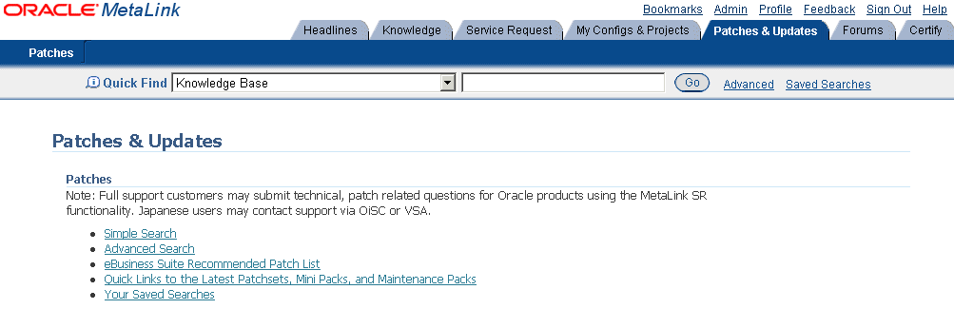
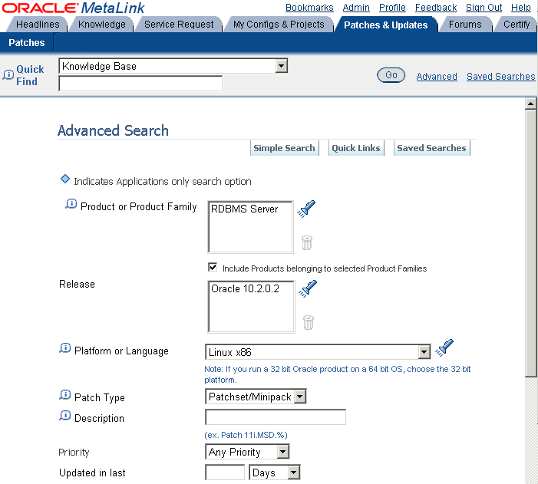
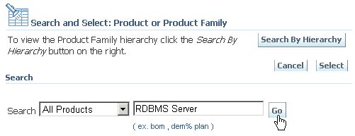
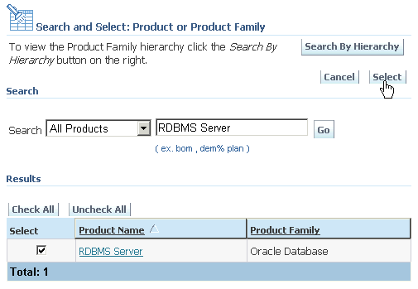
Download and Install Patch Updates
Notes:
Download and Install Patch Updates
Refer to the OracleMetaLink Web site for required patch updates for your installation.
To download the required patch updates:
1. Use a Web browser to log in to the OracleMetaLink Web site: http://metalink.oracle.com.
2. On the main OracleMetaLink page, click Patches and Updates.
3. On the Patches & Updates page, click Advanced Search.
4. On the Advanced Search page, click the search icon next to the Product or Product Family field.
5. In the Search field, enter RDBMS Server and click Go. Select RDBMS Server under the Results heading and click Select. RDBMS Server appears in the Product or Product Family field. The current release appears in the Release field.

Slide 25
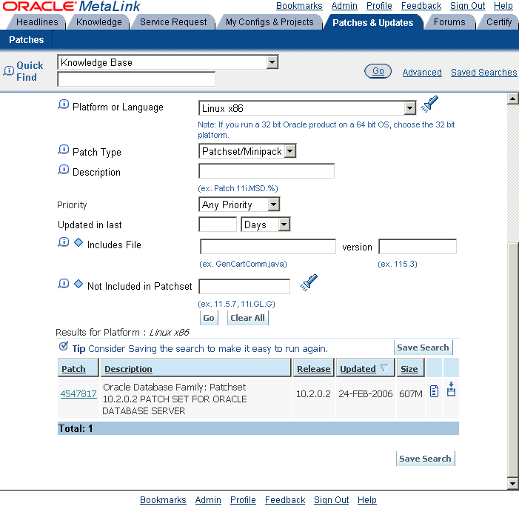
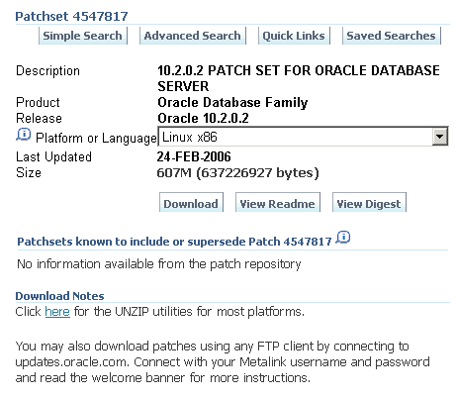
Download and Install Patch Updates
Notes:
Download and Install Patch Updates (continued)
6. Select your platform from the list in the Platform or Language field, and click Go. Any available patch updates appear under the Results heading.
7. Click the number of the patch that you want to download.
8. On the Patchset page, click View README and read the page that appears. The README page contains information about the patchset and how to apply the patches to your installation.
9. Return to the Patchset page, click Download, and save the file on your system.
10. Use the unzip utility provided with Oracle Database 10g to uncompress the Oracle patch updates that you downloaded from OracleMetaLink. The unzip utility is located in the $ORACLE_HOME/bin directory.

Slide 26
Rolling Release Upgrade Using SQL Apply
Clients
1
Clients
Logs
queue
2
Logs
ship
Patch set
upgrades
Version n
Version n
Version n
Version n+1
Major
release
upgrades
Initial SQL Apply setup
Upgrade standby site
4
Clients
Clients
3
Logs
ship
Logs
ship
Cluster
software
and
hardware
upgrades
Version n+1
Version n+1
Version n
Version n+1
Switchover, upgrade standby
Run mixed to test
Notes:
Rolling Release Upgrade Using SQL Apply
Beginning with Oracle Database 10.1.0.3 and continuing with later versions, a logical standby database can operate at a later Oracle release than on the primary when using SQL Apply to execute a rolling database upgrade. For example, using SQL Apply and logical standby databases, you are able to upgrade the Oracle database software from patchset release 10.2.0.n to the next database 10.2.0.(n+1) patchset release. Step 1 in the slide shows the Data Guard configuration before the upgrade begins, with the primary and logical standby databases both running the same Oracle software version. In step 2, you stop SQL Apply and upgrade the Oracle database software on the logical standby database to version n+1. During the upgrade, redo data accumulates on the primary system. In step 3, you restart SQL Apply, and the redo data that was accumulating on the primary system is automatically transmitted and applied on the newly upgraded logical standby database. The Data Guard configuration can run the mixed versions for an arbitrary period. In step 4, you perform a switchover. Then you activate the user applications and services on the new primary database. Before you can enable SQL Apply again, you need to upgrade the new standby site. This is because the new standby site does not understand new redo information. Finally, you raise the compatibility level on each database.
Note: SQL Apply does not support all data types. This can prevent you from using this method. A possible alternative is to use Oracle Streams in this case.

Slide 27
Database High Availability: Best Practices
Use SPFILE. | Create two or more control files. | Set CONTROL_FILE_RECORD_KEEP_TIME long enough. | Multiplex production and standby redo logs
Log checkpoints to the alert log. | Use auto-tune checkpointing. | Enable ARCHIVELOG mode and use a flash recovery area. | Enable Flashback Database.
Enable block checking. | Use Automatic Undo Management. | Use locally managed tablespaces. | Use Automatic Segment Space Management.
Use resumable space allocation. | Use Database Resource Manager. | Register all instances with remote listeners. | Use temporary tablespaces.
Notes:
Database High Availability: Best Practices
The table in the slide gives you a short summary of the recommended practices that apply to single-instance databases, RAC databases, and Data Guard standby databases.
These practices affect the performance, availability, and mean time to recover (MTTR) of your system. Some of these practices may reduce performance, but they are necessary to reduce or avoid outages. The minimal performance impact is outweighed by the reduced risk of corruption or the performance improvement for recovery.
Note: For more information about how to set up the features listed in the slide, refer to the following documents:
Administrator’s Guide
Data Guard Concepts and Administration
Net Services Administrator’s Guide

Slide 28
How Many ASM Disk Groups per Database
  Two disk groups are recommended.
    Leverage maximum of LUNs.
    Backups can be stored on one
    FRA disk group.
    Lower performance may be
    used for FRA (or inner tracks).
  Exceptions:
    Additional disk groups for different capacity or performance characteristics
    Different ILM storage tiers
Data DG
FRA DG
ERP DB
CRM DB
HR DB
Notes:
How Many ASM Disk Groups per Database
Most of the time, only two disk groups are enough to share the storage between multiple databases.
That way you can maximize the number of Logical Unit Numbers (LUNs) used as ASM disks, which gives you the best performance, especially if these LUNs are carved on the outer edge of your disks.
Using a second disk group allows you to have a backup of your data by using it as your common flash recovery area (FRA). You can put the corresponding LUNs on the inner edge of your disks because less performance is necessary.
The two noticeable exceptions to this rule are whenever you are using disks with different capacity or performance characteristics, or when you want to archive your data on lower-end disks for Information Lifecycle Management (ILM) purposes.

Slide 29

Database Storage Consolidation
  Shared storage across several databases:
    RAC and single-instance databases can use the same ASM instance.
  Benefits:
    Simplified and centralized management
    Higher storage utilization
    Higher performance
Payroll
GL
Payroll & GL
…
…
…
10  50 GB
10  50 GB
10  100 GB
Notes:
Database Storage Consolidation
In Oracle Database 10g Release 2, Oracle Clusterware does not require an Oracle Real Application Clusters license. Oracle Clusterware is now available with ASM and single-instance Oracle Database 10g allowing support for a shared clustered pool of storage for RAC and single-instance Oracle databases.
This allows you to optimize your storage utilization by eliminating wasted, over-provisioned storage. This is illustrated in the slide, where instead of having various pools of disks used for different databases, you consolidate all that in one single pool shared by all your databases.
By doing this, you can reduce the number of LUNs to manage by increasing their sizes, which gives you a higher storage utilization as well as a higher performance.
Note: RAC and single-instance databases could not be managed by the same ASM instance in Oracle Database 10g Release 1.

Slide 30
Which RAID Configuration for Best Availability?
A. ASM mirroring
B. Hardware RAID 1 (mirroring)
C. Hardware RAID 5 (parity protection)
D. Both ASM mirroring and hardware RAID
Answer:
Depends on business requirement and budget (cost, availability, performance, and utilization)
ASM leverages hardware RAID.
Notes:
Which RAID Configuration for Best Availability?
To favor availability, you have multiple choices as shown in the slide.
You could just use ASM mirroring capabilities, or hardware RAID 1 (Redundant Array of Inexpensive Disks) which is a hardware mirroring technique, or hardware RAID 5. The last possible answer, which is definitely not recommended, is to use both ASM mirroring and hardware mirroring. Oracle recommends the use of external redundancy disk groups when using hardware mirroring techniques to avoid an unnecessary overhead.
Therefore, between A, B, and C, it depends on your business requirements and budget.
RAID 1 has the best performance but requires twice the storage capacity. RAID 5 is a much more economical solution but with a performance penalty essentially for write-intensive workloads.

Slide 31
Should You Use RAID 1 or RAID 5?
RAID 1 (Mirroring)
  Recommended by Oracle
  Most demanding applications
Pros:
  Best redundancy
  Best performance
  Low recovery overhead
Cons:
  Requires higher capacity
RAID 5 (Parity)
  DSS and moderate OLTP
Pros:
  Requires less capacity
Cons:
  Less redundancy
  Less performance
  High recovery overhead
Notes:
Should You Use RAID 1 or RAID 5?
RAID 1 is a mirroring technique. Mirroring involves taking all writes issued to a given disk and duplicating the write to another disk. In this way, if there is a failure of the first disk, the second disk, or mirror, can take over without any data loss.
The goal of the RAID-5 design is to provide a reliable, high-performance array of disks with the minimum amount of redundant hardware. RAID 5 is based on the use of parity protection across several drives in order to provide protection against disk failure. The RAID-5 configuration is essentially a striped configuration, like RAID 0, with an additional disk added to cater to the additional storage needed for the parity information. With the data striped across the drives in this way, the read performance of RAID 5 is comparable to that of RAID 0. RAID-5 writes, on the other hand, are almost legendary for their poor performance.
The slide lists the pros and cons of using both techniques, and although Oracle recommends using RAID 1, you need to take into account that you have to double the number of your disks to store the same amount of data. The general rule of thumb is to deploy RAID 5 where cost of storage is critical and performance is not the primary goal, and for applications with primary read operations such as data warehouse applications. The Flash Recovery Area disk group can be another good use of RAID 5, where the storage capacity requirement is the highest and predominantly sequential I/O.
Note: The ORION tools (http://www.oracle.com/technology/software/index.html#util) can be used to test and determine the pros and cons of storage arrays for your application.

Slide 32

Should You Use ASM Mirroring Protection?
  Best choice for low-cost storage
  Enables extended clustering solutions
  No hardware mirroring
Notes:
Should You Use ASM Mirroring Protection?
Basically, leverage the storage array hardware RAID-1 mirroring protection when possible to offload the mirroring overhead from the server. Use ASM mirroring in the absence of a hardware RAID capability.
However hardware RAID 1 in most Advanced Technology Attachment (ATA) storage technologies is inefficient and degrades the performance of the array even more. Using ASM redundancy has proven to deliver much better performance in ATA arrays.
Because the storage cost can grow very rapidly whenever you want to achieve extended clustering solutions, ASM mirroring should be used as an alternative to hardware mirroring for low-cost storage solutions.
Note: For more information about the Oracle Resilient Low-cost Storage Initiative, see the Web site at: http://www.oracle.com/technology/deploy/availability/htdocs/lowcoststorage.html.

Slide 33
What Type of Striping Works Best?
A. ASM only striping (no RAID 0)
B. RAID 0 and ASM striping
C. Use LVM
D. No striping
Answer:
A and B
ASM and RAID striping are complementary.
Notes:
What Type of Striping Works Best?
As shown in the slide, you can use ASM striping only, or you can use ASM striping in combination with RAID 0.
With RAID 0, multiple disks are configured together as a set, or a bank, and data from any one data file is spread, or striped, across all the disks in the bank.
Combining both ASM striping and RAID striping is called stripe-on-stripe. This combination offers good performance too.
However, there is no longer a need to use a Logical Volume Manager (LVM) for your database files, nor it is recommended to not use any striping at all.

Slide 34
ASM Striping Only
Pros:
  Drives evenly distributed for Data & FRA
  Higher bandwidth
  Allows small incremental growth (73 GB)
  No drive contention
Cons:
  Not well balanced across
  ALL disks
  LUN size limited to disk size
Data DG
Oracle DB size: 1 TB
FRA DG
Storage configuration:
8arrays with
1273 GB disks per array
1 TB
1673 GB
LUNs
2 TB
3273 GB
LUNs
RAID 1
Notes:
ASM Striping Only
In the case shown in this slide, you want to store a one-terabyte database with a corresponding two-terabyte flash recovery area. You use RAID 1 to mirror each disk. In total, you have eight arrays of twelve disks, with each disk being 73 GB. ASM mirroring and hardware RAID 0 are not used.
In addition, each ASM disk is represented by one entire LUN of 73 GB. This means that the Data disk group (DG) is allocated 16 LUNs of 73 GB each.
On the other side, the Flash Recovery Area disk group is assigned 32 LUNs of 73 GB each.
This configuration enables you to evenly distribute disks for your data and backups, achieving good performance and allowing you to manage your storage in small incremental chunks.
However, using a restricted number of disks in your pool does not balance your data well across all your disks. In addition, you have many LUNs to manage at the storage level.

Slide 35
Hardware RAID–Striped LUNs
Pros:
  Fastest region for Data DG
  Balanced data distribution
  Fewer LUNs to manage while max spindles
Cons:
  Large incremental growth
  Data & FRA “contention”
Data DG
Oracle DB size: 1 TB
FRA DG
Storage configuration:
8arrays with
1273 GB disks per array
1 TB
4250 GB
LUNs
2 TB
4500 GB
LUNs
RAID 0+1
Notes:
Hardware RAID–Striped LUNs
In the case shown in this slide, you want to store a one-terabyte database with a corresponding two-terabyte flash recovery area. You use RAID 0+1, which is a combination of hardware striping and mirroring to mirror and stripe each disk. In total, you have eight arrays of twelve disks, with each disk being 73 GB. ASM mirroring is not used.
Here, you can define bigger LUNs not restricted to the size of one of your disk. This allows you to put the Data LUNs on the fastest region of your disks, and the backup LUNs on slower parts. By doing this, you achieve a better data distribution across all your disks, and you end up managing a significantly less number of LUNs.
However, you must manipulate your storage in much larger chunks than in the previous configuration.
Note: The hardware stripe size you choose is also very important because you want 1 MB alignment as much as possible to keep in synch with ASM AUs. Therefore, selecting power-of-two stripe sizes (128 KB or 256 KB) is better than selecting odd numbers. Storage vendors typically do not offer many flexible choices depending on their storage array RAID technology and can create unnecessary I/O bottlenecks if not carefully considered.

Slide 36
Hardware RAID–Striped LUNs HA
Pros:
  Fastest region for Data DG
  Balanced data distribution
  Fewer LUNs to manage
  More high available
Cons:
  Large incremental growth
  Might waste space
Data DG
Oracle DB size: 1 TB
FRA DG
Storage configuration:
8arrays with
1273 GB disks per array
1 TB
2500 GB
LUNs
1.6 TB
2800 GB
LUNs
RAID 0+1
Notes:
Hardware RAID–Striped LUNs HA
In the case shown in this slide, you want to store a one-terabyte database with a corresponding 1.6-TB flash recovery area. You use RAID 0+1, which is a combination of hardware striping and mirroring to mirror and stripe each disk. In total, you have eight arrays of twelve disks, with each disk being 73 GB. ASM mirroring is not used.
Compared to the previous slide, you use bigger LUNs for both the Data disk group and the Flash Recovery Area disk group. However, the presented solution is more highly available than the previous architecture because you separate the data from the backups into different arrays and controllers to reduce the risk of down time in case one array fails.
By doing this, you still have a good distribution of data across your disks, although not as much as in the previous configuration. You still end up managing a significantly less number of LUNs than in the first case.
However, you might end up losing more space than in the previous configuration. Here, you are using the same size and number of arrays to be consistent with the previous example.

Slide 37
It Is Real Simple
  Use external RAID protection when possible.
  Create LUNs by using:
    Outside half of disk drives for highest performance
    Small disk, high rpm (that is, 73 GB/15k rpm)
  Use LUNs with the same performance characteristics.
  Use LUNs with the same capacity.
  Maximize the number of spindles in your disk group.
Oracle Database 10g and ASM do the rest!
Notes:
It Is Real Simple
Use Oracle Database 10g ASM for volume and file management to equalize the workload across disks and eliminate hot spots. The following are simple guidelines and best practices when configuring ASM disk groups:
Use external RAID protection when possible.
Create LUNs using:
Outside half of disk drives for highest performance
Small disk with high rpm (for example, 73 GB with 15k rpm). The reason why spindle (platter) speed is so important is that it directly impacts both positioning time and data transfer. This means that faster spindle speed drives have improved performance regardless of whether they are used for many small, random accesses, or for streaming large contiguous blocks from the disk. The stack of platters in a disk rotates at a constant speed. The drive head, while positioned close to the center of the disk, reads from a surface that is passing by more slowly than the surface at the outer edges.
Maximize the number of spindles in your disk group.
LUNs provisioned to ASM disk groups should have the same storage performance and availability characteristics. Configuring mixed speed drives will default to the lowest common denominator.
ASM data distribution policy is capacity based. Therefore, LUNs provided to ASM should have the same capacity for each disk group to avoid imbalance and hot spots.

Slide 38
Extended RAC: Overview
  Full utilization of resources, no matter where they are located
  Fast recovery from site failure
Site A
RAC
database
Site B
Clients
Site A
RAC
database
Site B
Notes:
Extended RAC: Overview
Typically, RAC databases share a single set of storage and are located on servers in the same data center.
With extended RAC, you can use disk mirroring and Dense Wavelength Division Multiplexing (DWDM) equipment to extend the reach of the cluster. This configuration allows two data centers, separated by up to 100 kilometers, to share the same RAC database with multiple RAC instances spread across the two sites.
As shown in the slide, this RAC topology is very interesting, because the clients’ work gets distributed automatically across all nodes independently of their location, and in case one site goes down, the clients’ work continues to be executed on the remaining site. The types of failures that extended RAC can cover are mainly failures of an entire data center due to a limited geographic disaster. Fire, flooding, and site power failure are just a few examples of limited geographic disasters that can result in the failure of an entire data center.
Note: Extended RAC does not use special software other than the normal RAC installation.

Slide 39
Extended RAC Connectivity
  Distances over ten kilometers require dark fiber.
  Set up buffer credits for large distances.
Dark fiber
Site A
Site B
DWDM
device
DWDM
device
DB
copy
DB
copy
Public network
Clients
Notes:
Extended RAC Connectivity
In order to extend a RAC cluster to another site separated from your data center by more than ten kilometers, it is required to use DWDM over dark fiber to get good performance results.
DWDM is a technology that uses multiple lasers, and transmits several wavelengths of light simultaneously over a single optical fiber. DWDM enables the existing infrastructure of a single fiber cable to be dramatically increased. DWDM systems can support more than 150 wavelengths, each carrying up to 10 Gbps. Such systems provide more than a terabit per second of data transmission on one optical strand that is thinner than a human hair.
As shown in the slide, each site should have its own DWDM device connected together by a dark fiber optical strand. All traffic between the two sites is sent through the DWDM and carried on dark fiber. This includes mirrored disk writes, network and heartbeat traffic, and memory-to-memory data passage. Also shown on the graphic are the sets of disks at each site. Each site maintains a copy of the RAC database.
It is important to note that depending on the site’s distance, you should tune and determine the minimum value of buffer credits in order to maintain the maximum link bandwidth. Buffer credit is a mechanism defined by the Fiber Channel standard that establishes the maximum amount of data that can be sent at any one time.
Note: Dark fiber is a single fiber optic cable or strand mainly sold by telecom providers.

Slide 40
Extended RAC Disk Mirroring
  Need copy of data at each location
  Two options:
    Host-based mirroring
    Remote array-based mirroring
Recommended solution with ASM
Site A
Site B
Primary
Secondary
DB
copy
DB
copy
DB
copy
DB
copy
Notes:
Extended RAC Disk Mirroring
Although there is only one RAC database, each data center has its own set of storage that is synchronously mirrored using either a cluster-aware, host-based Logical Volume Manager (LVM) solution, such as SLVM with MirrorDiskUX, or an array-based mirroring solution, such as EMC SRDF.
With host-based mirroring (shown on the left of the slide), the disks appear as one set, and all I/Os get sent to both sets of disks. This solution requires closely integrated clusterware and LVM, and ASM is the recommended solution.
With array-based mirroring, shown on the right, all I/Os are sent to one site and are then mirrored to the other. In fact, this solution is like a primary/secondary site setup. If the primary site fails, all access to primary disks is lost. An outage may be incurred before you can switch to the secondary site.
Note: With extended RAC, it is critical to design the cluster in a manner that ensures that the cluster can achieve quorum after a site failure. For more information, refer to the Oracle Technology Network site.

Slide 41
Achieving Quorum with Extended RAC
Third
site
Voting disk (NFS or iSCSI)
Redundant public network
Redundant private network
Site A
Site B
Redundant SAN with ASM mirroring
RAC
database
RAC
database
Database files (ASM failure group)
OCR
Voting Disk
Database files (ASM failure group)
OCR
Voting Disk
Notes:
Achieving Quorum with Extended RAC
A node must be able to access strictly more than half of the voting disks at any time; otherwise, that node will be evicted from the cluster. Extended clusters are generally implemented with only two storage systems, one at each site. This means that the site that houses the majority of the voting disks is a potential single point of failure for the entire cluster. To prevent this potential outage, Oracle Clusterware supports a third voting disk on an inexpensive low-end standard NFS mounted device somewhere on the network. It is thus recommended to put this third NFS voting disk on a dedicated server that is visible from both sites. This situation is illustrated in the slide. The goal is for each site to run independently of the other when a site failure occurs.
Note: For more information about NFS configuration of the third voting disk, refer to the Oracle Technology Network site.

Slide 42
ASM Preferred Mirror Read: Overview
Site A
Site B
P
S
Site A
Site B
P
P: Primary AU
S
S: Secondary AU
Notes:
ASM Preferred Mirror Read: Overview
When you configure ASM failure groups in Oracle Database 10g, ASM always reads the primary copy of a mirrored extent. It may be more efficient for a node to read from a failure group extent that is closest to the node, even if it is a secondary extent. This is especially true in extended cluster configurations (when nodes are spread across several sites) where reading from a local copy of an extent provides improved performance.
With Oracle Database 11g, you can do this by configuring the preferred mirror read by using the new ASM_PREFERRED_READ_FAILURE_GROUPS initialization parameter to specify a list of preferred mirror read names. The disks in those failure groups become the preferred read disks. Thus, every node can read from its local disks. This results in higher efficiency and performance as well as reduced network traffic. The setting for this parameter is instance specific.

Slide 43
ASM Preferred Mirror Read: Setup
Setup
On first instance
ASM_PREFERRED_READ_FAILURE_GROUPS=DATA.SITEA
On second instance
ASM_PREFERRED_READ_FAILURE_GROUPS=DATA.SITEB
Monitor
SELECT preferred_read FROM v$asm_disk;
SELECT * FROM v$asm_disk_iostat;
Notes:
ASM Preferred Mirror Read: Setup
To configure this feature, set the new ASM_PREFERRED_READ_FAILURE_GROUPS initialization parameter. This parameter is a multivalued parameter and should contain a string with a list of failure group names separated by commas. Each failure group name specified should be prefixed with its disk group name and a “.” character. This parameter is dynamic and can be modified using the ALTER SYSTEM command at any time. An example is shown in the slide. However, this initialization parameter is valid only for ASM instances. With the extended cluster, the failure groups specified in this parameter should contain only those disks that are local to the corresponding instance.
The new column PREFERRED_READ has been added to the V$ASM_DISK view. Its format is a single character. If the disk group to which the disk belongs pertains to a preferred read failure group, the value of this column is Y.
To identify specific performance issues with the ASM preferred read failure groups, use the V$ASM_DISK_IOSTAT view. This view displays the disk input/output (I/O) statistics for each ASM client. If this view is queried from a database instance, only the rows for this instance are shown.

Slide 44
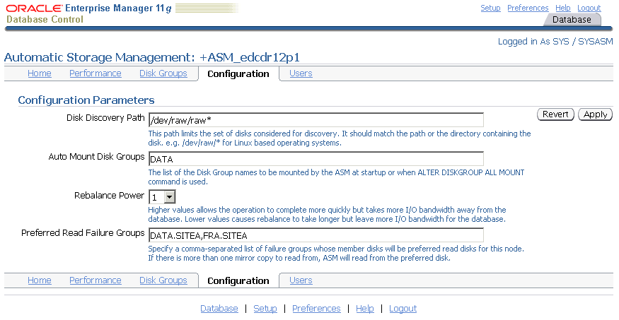
Enterprise Manager ASM Configuration Page
Notes:
Enterprise Manager ASM Configuration Page
You can specify a set of disks as preferred disks for each ASM instance by using Enterprise Manager. The preferred read attributes are instance specific. In Oracle Database 11g, the Preferred Read Failure Groups field (asm_preferred_read_failure_group) is added to the configuration page.
This parameter takes effect only before the disk group is mounted or when the disk group is created. It applies only to newly opened files or to a newly loaded extent map for a file.

Slide 45
ASM Preferred Mirror Read: Best Practice
Two sites: Normal redundancy
Two sites: High redundancy
P
S
P
S
S
S
S
P
Only two failure groups: One for each instance
Max four failure groups: Two for each instance
Three sites: High redundancy
P
S
S
Only three failure groups: One for each instance
Notes:
ASM Preferred Mirror Read: Best Practice
In practice, there are only a limited number of good disk group configurations in an extended cluster. A good configuration takes into account both performance and availability of a disk group in an extended cluster. Here are some possible examples:
For a two-site extended cluster, a normal redundancy disk group should have only two failure groups; all disks local to one site should belong to the same failure group. Also, no more than one failure group should be specified as a preferred read failure group by each instance. If there are more than two failure groups, ASM may not mirror a virtual extent across both sites. Furthermore, if the site with more than two failure groups were to go down, it would take the disk group down as well. If the disk group to be created is a high-redundancy disk group, at most two failure groups should be created on each site with its local disks, with both local failure groups specified as preferred read failure groups for the local instance.
For a three-site extended cluster, a high redundancy disk group with three failure groups should be used. In this way, ASM can guarantee that each virtual extent has a mirror copy local to each site and that the disk group is protected against a catastrophic disaster on any of the three sites.

Slide 46
Additional Data Guard Benefits
  Greater disaster protection
    Greater distance
    Additional protection against corruptions
  Better for planned maintenance
    Full rolling upgrades
  More performance neutral at large distances
    Option to do asynchronous
  If you cannot handle the costs of a DWDM network, Data Guard still works over cheap, standard networks.
Notes:
Additional Data Guard Benefits
Data Guard provides a greater disaster protection:
Distance over 100 kilometers without performance hit
Additional protection against corruptions because it uses a separate database
Optional delay to protect against user errors
Data Guard also provides better planned maintenance capabilities by supporting full rolling upgrades.
Also, if you cannot handle the costs of a DWDM network, Data Guard still works over inexpensive, standard networks.

Slide 47
Using a Test Environment
  The most common cause of down time is change.
  Test your changes on a separate test cluster before changing your production environment.
Production
cluster
Test
cluster
RAC
database
RAC
database
Notes:
Using a Test Environment
Change is the most likely cause of down time in a production environment. A proper test environment can catch more than 90 percent of the changes that could lead to a down time of the production environment, and is invaluable for quick test and resolution of issues in production.
When your production environment is RAC, your test environment should be a separate RAC cluster with all the identical software components and versions.
Without a test cluster, your production environment will not be highly available.
Note: Not using a test environment is one of the most common errors seen by Oracle Support Services.

Slide 48
Summary
In this lesson, you should have learned how to:
  Design a Maximum Availability Architecture in your environment
  Determine the best RAC and Data Guard topologies for your environment
  Configure the Data Guard Broker configuration files in a RAC environment
  Decide on the best ASM configuration to use
  Patch your RAC system in a rolling fashion
Notes:
Oracle Database 11g: RAC Administration 12 - <number>
Note: There is no practice for this lesson.

